Slide 1
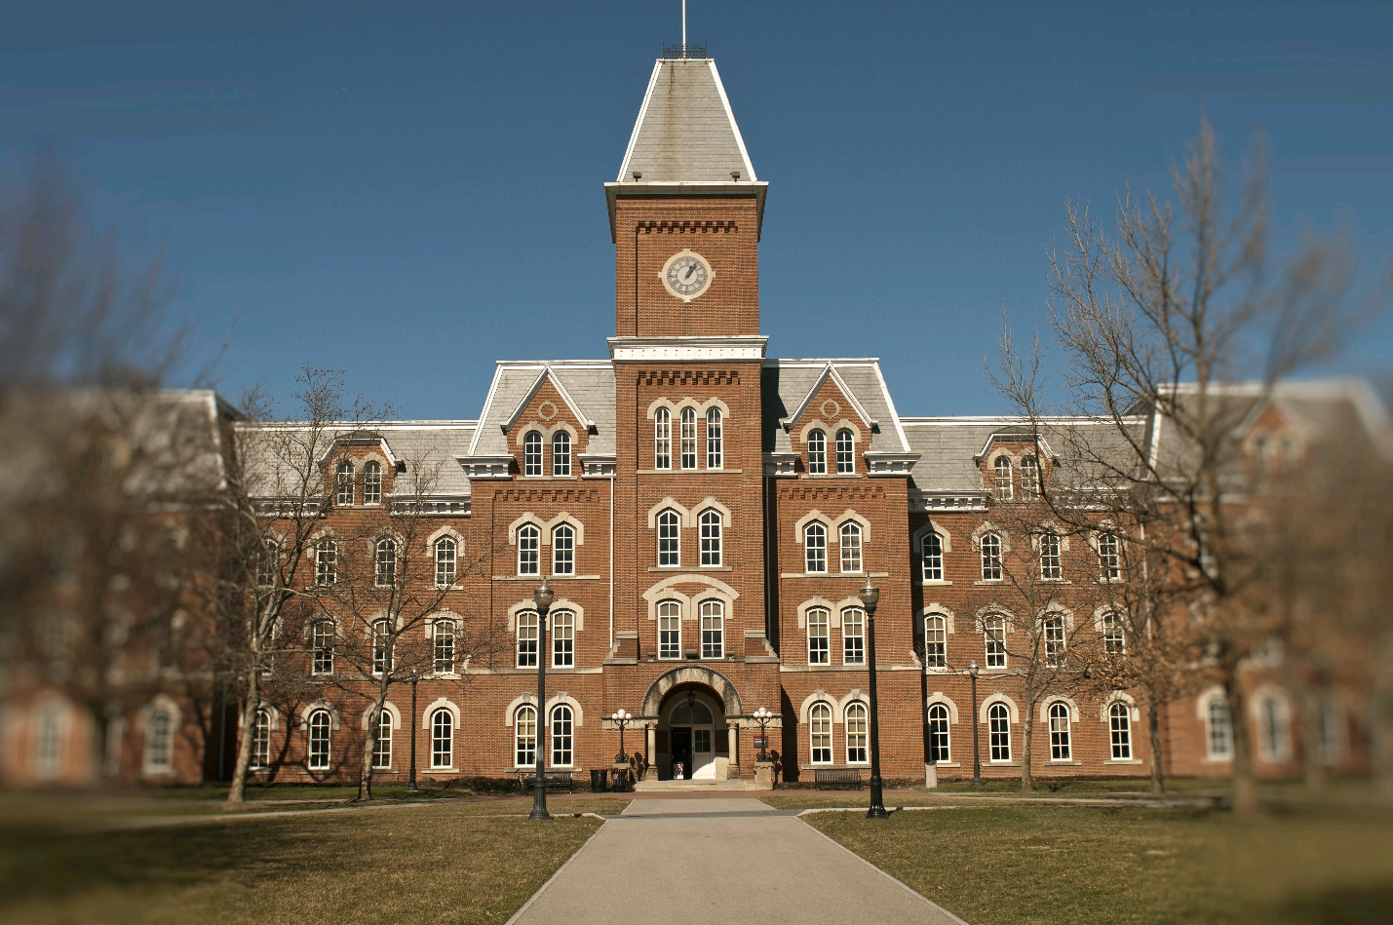
_FaciliRate_
_Computer Science Squad (CSS)_

Slide 2
Overview
Schema presented through E.R. diagram
Controllers and Views (Home, User, Result, Room, and Facility)
Frameworks
Demo

Slide 3
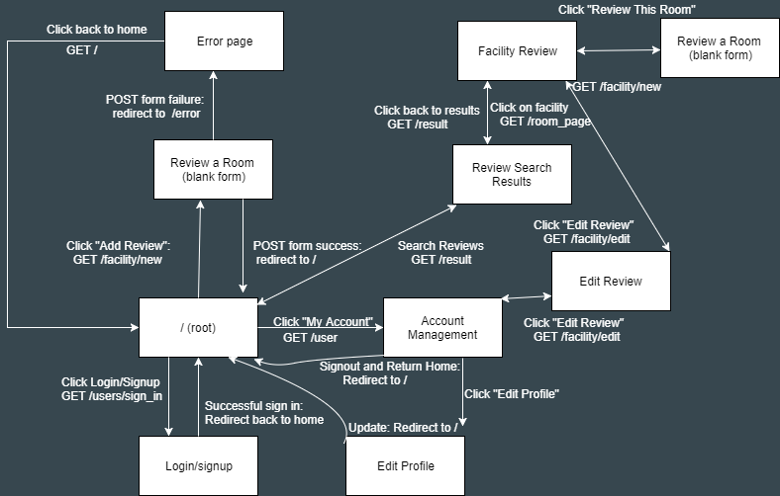
Website Diagram

Slide 4
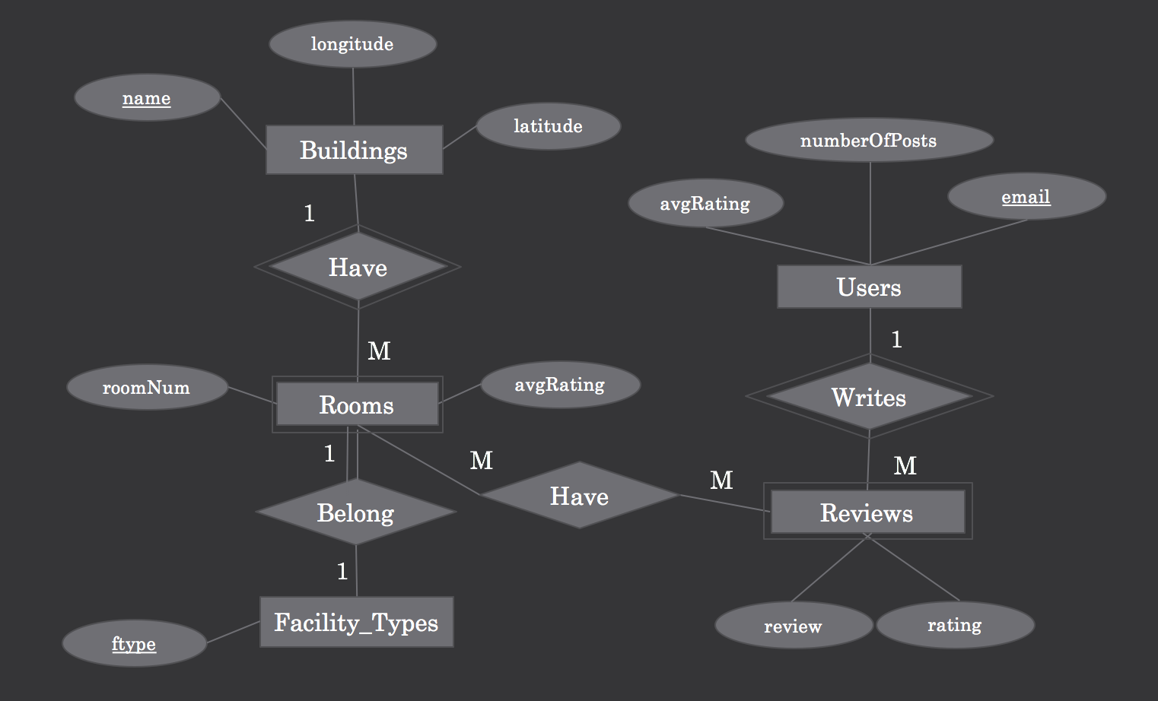
E.R Diagram
Notes:
5 Main tables
-discuss relationship Weak entities are rooms and reviews because cannot stand on their own, is defined by foreign key relationship
--Building to rooms (many to 1) All rooms need to have a facility type attached to it but not all facility type are rooms (i.e garages, bathrooms)
--Rooms to facility type (1:1)
--Rooms to Reviews (1:M)
--Users to Review (1:M)

Slide 5
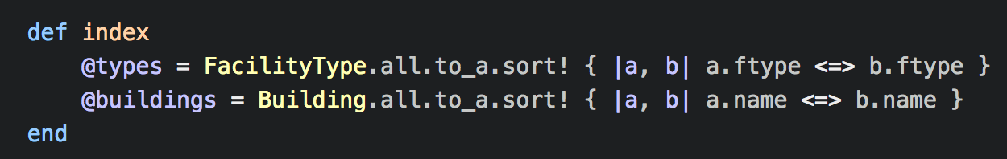
Home Controller
Sets up the variables needed for the home page to give user options for autocomplete text entry (Buildings) and for drop down menus (Facility Types)
Creates an array variables to contain all possible types of facilities and all possible buildings
Notes:
All come from the database
First get all rows from the table then convert that to an array that can be sorted by their type, name, etc
Used in the home page

Slide 6
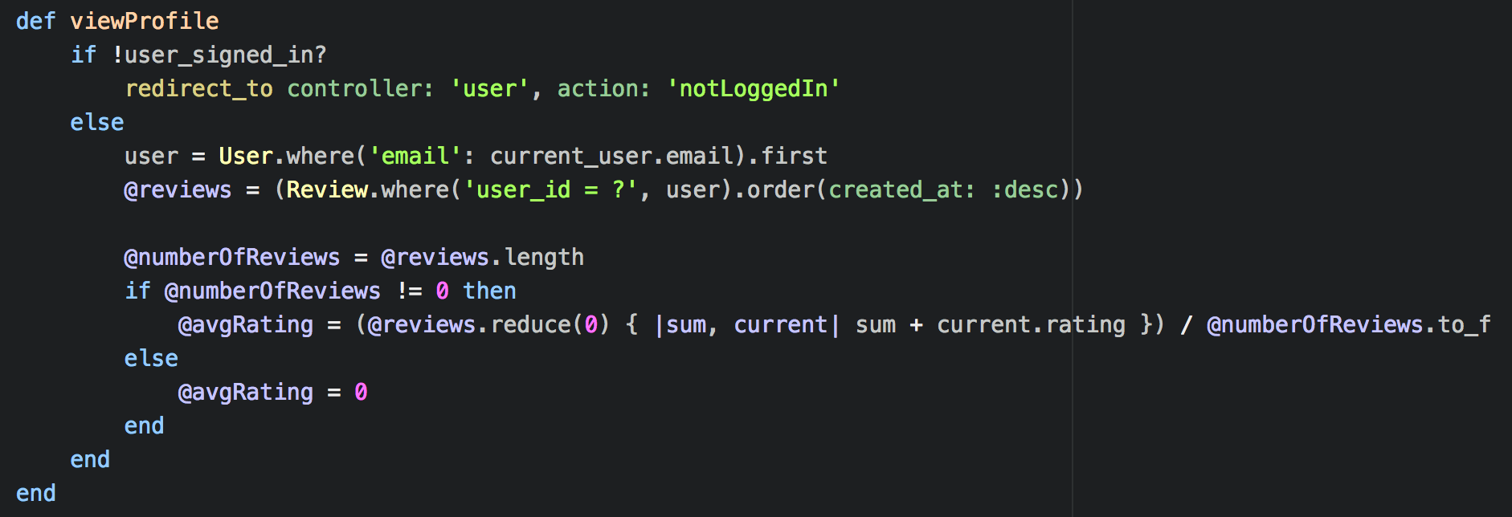
User Controller
Allows only signed in users to reach the profile page
Assigns a variables to contain all reviews made by the user, the number of reviews made by the user and the average rating made by the user
Notes:
All from the database tables
If user is not logged in, redirect to an error page
Gets the use id number by checking the user table for first occurrence of a user with email equal to the current_user’s email (should only be one so first works)
Uses that ID to check the reviews table and get ALL reviews made by that user id
Gets the number of posts by just checking the length of the array
Gets the average rating by summing all the review ratings then dividing by number (0 if no posts to avoid divide by 0)

Slide 7
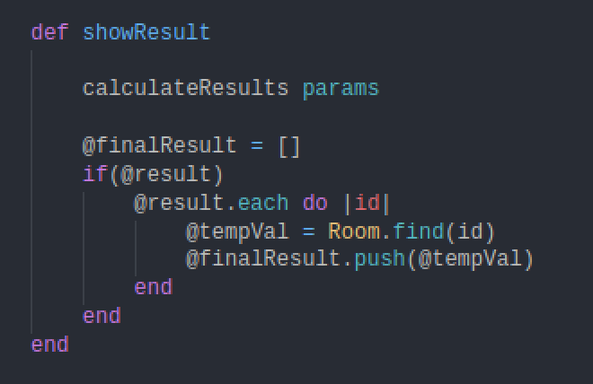
Result Controller
Search request in homepage routes to showResult method in result controller
@finalResult contains array of rooms and in the model the variable is looped to create a table
Notes:
-First the parameters are send to helper method in application controller where it goes through a series of if else statements to find rooms matching the filters/categories set by the user

Slide 8
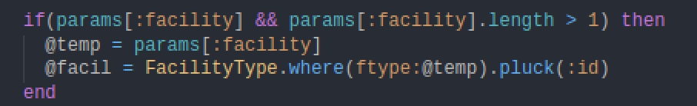
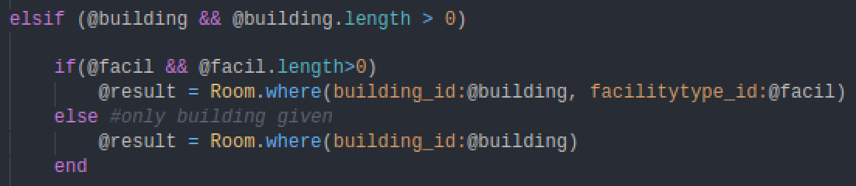
Result Controller(Helper)
Helper method is called from result controller with arguments
Goes through nested if else conditions and obtain rooms matching the criteria user requested
Notes:
-the helper method returns a variable @result where in the controller we check if it exists if it does, we obtain all of the rooms id and obtain all the room with the ids in the result array

Slide 9
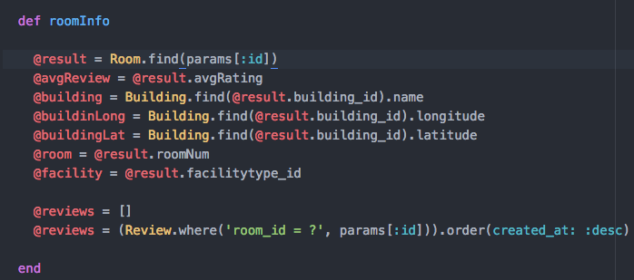
Room Page Controller
Gathers building, facility, and location information about a specific room
Creates an array of reviews for the room to be displayed on the room’s page
Notes:
Gets passed a room id and uses it find the the information like average reviews, building location, and facility type for the room
Gathers the information to display maps, reviews and ratings about individual rooms

Slide 10
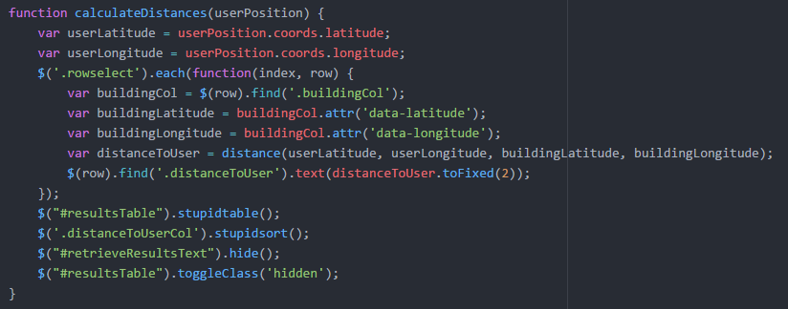
Geolocation
Fetched every OSU building, along with its longitude and latitude and inserted into database
HTML5 Geolocation API
Handling if not available
Haversine formula to calculate distance from user coordinates to each building
Displaying distance in results table
Sortable using jQuery plugin

Slide 11
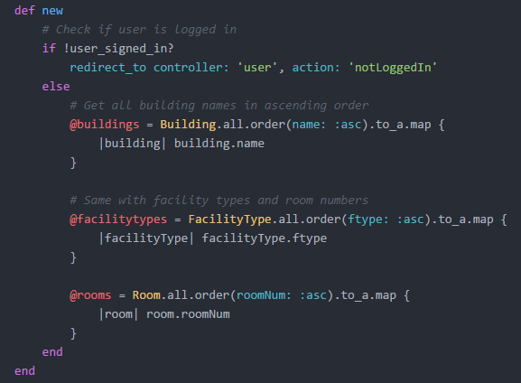
Facility Controller - New
Renders an empty form for the user to create a review
Fetches buildings, facility types, and rooms so client input fields have autocomplete suggestions
Notes:
Finds the id from the params then gets the review and the room it is reviewing
Updates the room values then saves the new ones
Destroys the review to delete it from the table

Slide 12
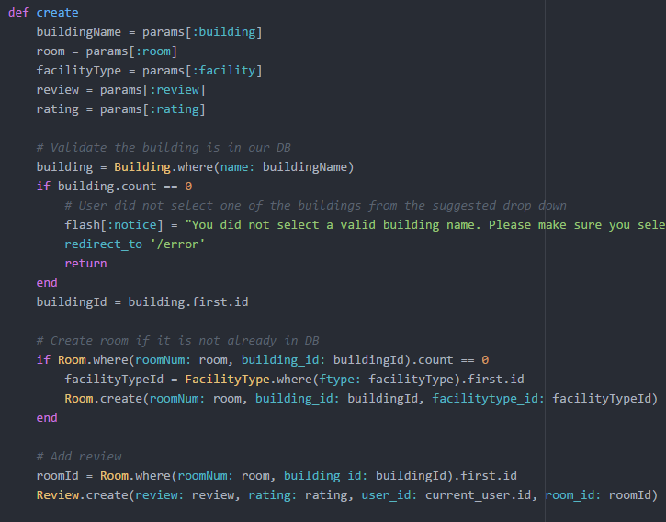
Facility Controller - Create
Given a filled form of review data, creates a review in the database
Creates facility if not already present in database
In addition to client-side validation, performs some basic server-side validation
Notes:
Finds the id from the params then gets the review and the room it is reviewing
Updates the room values then saves the new ones
Destroys the review to delete it from the table

Slide 13
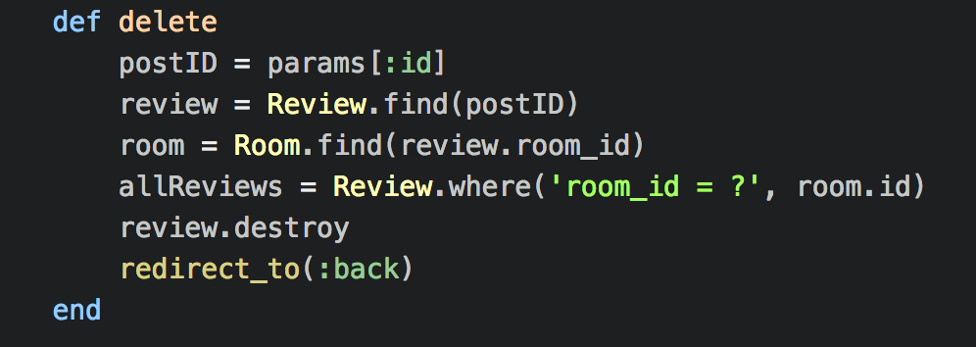
Facility Controller - Delete
Deletes the review that is passed through the url from the Review table
Updates the value of the average rating of the room to account for the deleted review
Notes:
Finds the id from the params then gets the review and the room it is reviewing
Updates the room values then saves the new ones
Destroys the review to delete it from the table

Slide 14
Frameworks Used in FaciliRate
Bootstrap
Devise
jQuery
Autocomplete
gmaps4rails
Notes:
Bootstrap - Gives CSS and JavaScript code to help in the design of elements like buttons, links, drop down menus and more
Devise - Gives the functionality to support the logging into the website, logging out and maintaining the table containing information about the users
jQuery - table sorting, autocomplete, stupidtables plugin, navigation
Autocomplete - Used to allow the user to enter text to the building search which is then autocompleted with suggestions instead of using a massive drop down menu
gmaps4rails - Allowed us to add a google map to every room page

Slide 15
Demo

